Slide 1
Software Architecture & Construction
Design Patterns -2

Slide 2
Design Patterns
Definition
  Description of communicating objects and classes that are customized to solve a general design problem in a particular context
Where do design patterns come from?

Slide 3
Some History
Christopher Alexander (1977)
  Design patterns in architecture (buildings)
Kent Beck and Ward Cunningham (1987)
  Using Pattern Languages for OO Programs
Jim Coplien (1991)
  Programming styles and idioms for C++
Ralph Johnson (1992)
  Documenting frameworks using patterns
Gamma, Helm, Johnson, Vlisside (GoF) (1995)
  Design Patterns. Elements of Reusable Object-Oriented Software

Slide 4
Design Patterns
Main contributions
  Establishes a “standard” to describe OO designs
  Names and catalogues recurring OOD solutions
  Provide a way to transmit OOD design expertise

Slide 5
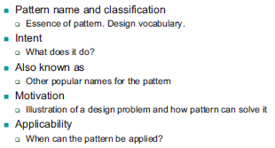
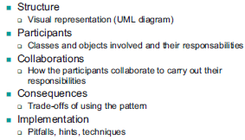
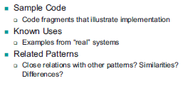
Describing patterns
2
1
3

Slide 6
Observer pattern -1
Pattern name and classification
  Name: Observer
  Classification: Behavioral pattern
Intent:
  Define a one-to-many dependency between objects so that when an object changes state, all its dependent are notified and updated automatically
Also known as:
  Dependents, Publish-Subscribe
Motivation:
  Graphical toolkit implementation – GUI development
Applicability:
  One change can trigger an unknown number of updates
  Notification of changes can be decoupled
  Two types of class – one dependent of the other

Slide 7
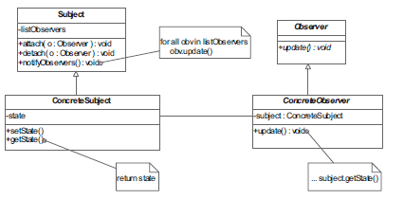
Observer pattern -2
Structure
  Visual representation (UML diagram)

Slide 8
Observer pattern -3
Participants
  Subject : knows observers, attach and detach observers
  Observer: updating interface for objects target of notification
  Concrete subject: has state of interest for concrete observers
  Concrete observer: refers to a concrete subject, performs updates
Collaborations (sequence diagram can be used)
  Concrete subject notifies its observers
  Concrete observers gets new state
Consequences
  Varies subjects and observers independently
  Add and remove observers at any time

Slide 9
Observer pattern -5
Implementation
  Mapping subjects to their observers: trade-off storage vs. access costs for mapping
  Observing more than one subject:
    Need to know who changed.
    Modification to update method (subject sends reference to itself)
  Who triggers the update (who calls notify)
    Subject: every operation that changes state notify
    Client: update changes can be done in batch, client can make mistakes or simply forget
  Dangling references to deleted subjects: notify observers to “unregister”
  Make sure subjects are in self-consistent state before notifying
  Avoid observer-specific update protocols: trade-off update information
  Specifying modifications of interest explicitly: register for only what observers are interested in
  Encapsulate complex update semantics: use additional objects to simplify updates

Slide 10
Observer pattern -5
Sample Code
  We saw examples last lecture
Known Uses
  GUI systems
Related Patterns
  Mediator – encapsulate complex update semantics, mediates among subjects and observers
  Singleton– make object that deals with complex update semantics unique and globally accessible

Slide 11
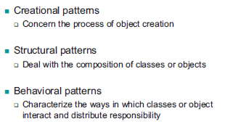
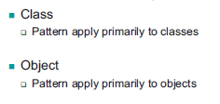
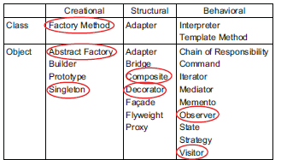
Design patterns classification
Classification
Scope
Classification map/examples

Slide 12
Activity for you – Visitor pattern

Slide 13
Your task
With use of a motivational example, describe how you would use the Visitor pattern in a software design
Ensure to discuss the pattern, explaining its intent, applicability, etc.

Slide 14
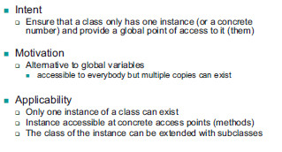
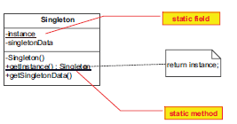
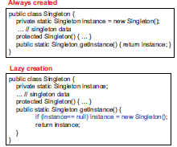
Singleton pattern
Description
UML view
Example use

Slide 15
Next time
Metamodelling
  UML stereotypes
  OCL
  MDA

